Slide 1
Object Oriented Programming

Slide 2
Basics on Java Programming
When we consider a Java program it can be defined as a collection of objects that communicate via invoking(invite) each other's methods.
Object - Objects have states and behaviors. Example: A dog has states - color, name, breed as well as behaviors -wagging, barking, eating. An object is an instance of a class.
Class - A class can be defined as a template/ blue print that describes the behaviors/states that object of its type support.
Methods - A method is basically a behavior. A class can contain many methods. It is in methods where the logics are written, data is manipulated and all the actions are executed.
Instance Variables - Each object has its unique set of instance variables. An object's state is created by the values assigned to these instance variables.

Slide 3
Basics on Java Programming
Basic Syntax:
Case Sensitivity - Java is case sensitive, which means identifier Hello and hello would have different meaning in Java.
Class Names - For all class names the first letter should be in Upper Case.
Method Names - All method names should start with a Lower Case letter.
Program File Name - Name of the program file should exactly match the class name.
public static void main(String args[]) - Java program processing starts from the main() method which is a mandatory part of every Java program.

Slide 4
Java Modifiers:
Like other languages, it is possible to modify classes, methods, etc., by using modifiers. There are two categories of modifiers:
Access Modifiers: default, public , protected, private
Non-access Modifiers: final, abstract, strictfp

Slide 5
Java Variables:
We would see following type of variables in Java:
Local Variables
Class Variables (Static Variables)
Instance Variables (Non-static variables)

Slide 6
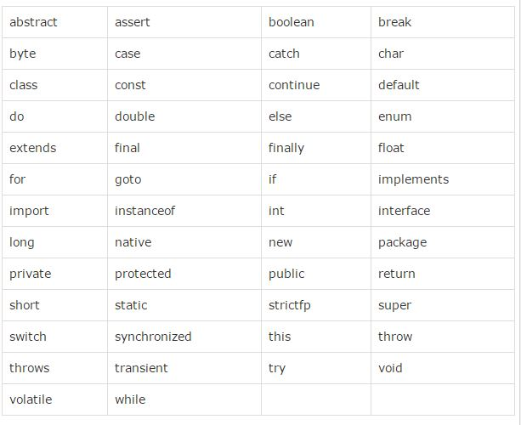
Java Keywords:

Slide 7
Inheritance
Inheritance is one of the feature of Object-Oriented Programming. Inheritance allows a class to use the properties and methods of another class.
The derived class is also called subclass/child and the base class is also known as super-class/parent class.
A super-class can have any number of subclasses. But a subclass can have only one superclass.
Java does not support multiple inheritance.

Slide 8
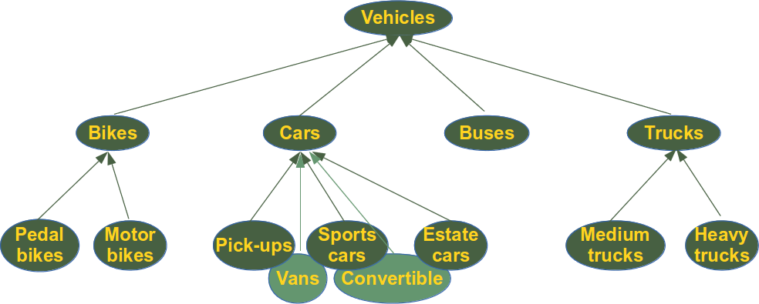
Inheritance

Slide 9
Types of inheritance
Single Inheritance
When a class extends another one class only then we call it a single inheritance.
Multiple Inheritance
Multiple Inheritance refers to the concept of one class extending (Or inherits) more than one base class/ parent class/super class.
Multilevel Inheritance
Multilevel inheritance refers to a mechanism in OO technology where one can inherit from a derived class, thereby making this derived class the base class for the new class.

Slide 10
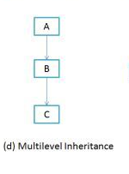
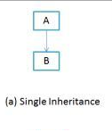
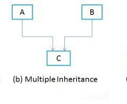
Types of inheritance

Slide 11

inheritance
The keyword used for inheritance is extends.

Slide 12
Encapsulation
Encapsulation in Java is a mechanism of wrapping the data (variables) and code acting on the data (methods) together as single unit.
In encapsulation the variables of a class will be hidden from other classes, and can be accessed only through the methods of their current class.
it is also known as data hiding.

Slide 13
Encapsulation
To achieve encapsulation in Java
Declare the variables of a class as private.
Provide public setter and getter methods to modify and view the variables values.
Encapsulation is also known as “data Hiding”.

Slide 14
Advantage of Encapsulation in java
By providing only setter or getter method, you can make the class read-only or write-only.
It provides you the control over the data.
It improves maintainability and flexibility and re-usability.

Slide 15
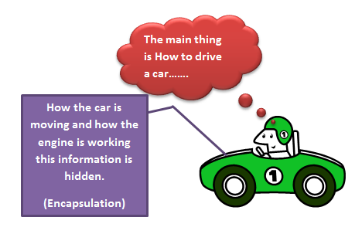
Encapsulation

Slide 16
Polymorphism
Polymorphism is the capability of a method to do different things based on the object that it is acting upon.
Polymorphism allows you define one interface and have multiple implementations.
The most common use of polymorphism in OOP occurs when a parent class reference is used to refer to a child class object.

Slide 17
Types of polymorphism
Runtime Polymorphism( or Dynamic polymorphism)
Method overriding is a perfect example of runtime polymorphism.
Compile time Polymorphism( or Static polymorphism)
Method overloading is a perfect example of runtime polymorphism.

Slide 18
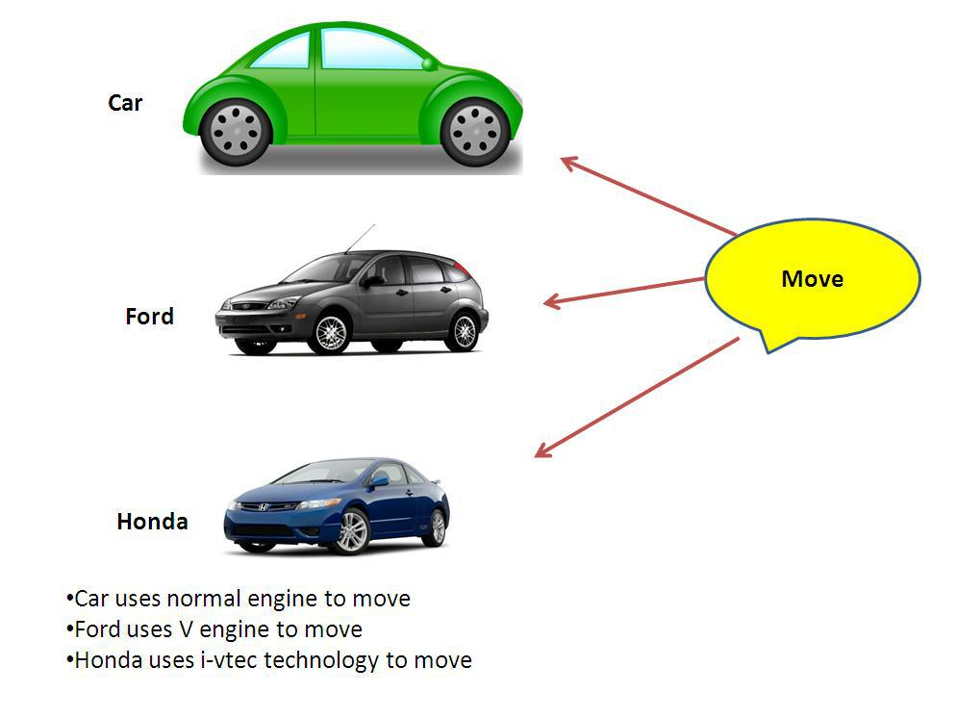
Polymorphism

Slide 19
Thank You

